Slide 1



SkyLink Airlines: Strategic International Expansion
BCG Winter Case Competition 2025
Sambaz Unal & Alex Buddery

Slide 2
Skylink Airlines: International Expansion Strategy
“SkyLink aims to reduce reliance on the North American market by expanding internationally with a focused, data-driven plan.”
Background
Target Market
Current Competition
Operates 540 aircraft — youngest fleet among competitors (avg. age 5.2 yrs) lower costs, better efficiency
Routes mostly domestic; limited international service (Canada, Mexico, Caribbean)
Positioned as a low-cost, high-efficiency carrier with strong customer satisfaction
Ancillary fees (baggage, seats, onboard purchases) are lowest among major U.S. competitors
High domestic load factor (85%) shows strong utilisation and network maturity
International load factor at 72%, lower than competitors; early-stage international presence with room to grow and optimise
SkyLink’s service model resonates with travellers who want a reliable, clean, and efficient experience at low cost
Target largely non-business passengers, including families, young adults, and independent tourists
Customers value transparent pricing and low additional charges for extras like baggage and seat selection
Budget-conscious leisure travellers who prioritise affordability and convenience over luxury
Attracts environmentally aware individuals through efforts like digital boarding passes and reduced single-use plastics
Competes with major U.S. carriers; Delta, United, and American Airlines
SkyLink’s annual revenue is $28.45B, smaller than Delta ($61.6B) and United ($57.06B), reflecting its leaner scale and growth phase
Operates fewer total routes (180) compared to Delta (311) and United (363), offering opportunity to expand network
Maintains a lower cost structure with reduced baggage, seat fees as well as cheaper in-flight purchases
Fleet is smaller but newer; average age of 5.2 years, significantly younger than Delta (14.9) and United (15.9), supporting fuel efficiency and lower maintenance

Slide 3








Market Entry Criteria
"Selecting the Right Market: Strategic Filters"
Market Demand & Connectivity
Inbound Tourism Volume.
VFR & Diaspora Demand
Existing Air Connectivity
Urban Population
Economic & Competitive Landscape
GDP per Capita / Middle Class Size
Regulatory Openness
Competitive Intensity
Fuel & Airport Cost Environment
Feasibility & Strategic Fit
Slot Availability
Geographic Fit / Hub Proximity
Political & Operational Stability
Strategic Alignment

Slide 4
Shortlisted Markets: Evaluating High-Potential Entry Options
A structured assessment of three promising international markets based on demand potential, diaspora links, connectivity gaps, and strategic fit with SkyLink’s business model.
Colombia
Philippines
Morocco
Attracted 6.7M tourists in 2024, with the US accounting for 25% of international arrivals
1.4M Colombians living in the US, supporting strong VFR (visiting friends and relatives) demand
Key cities like Medellín and Cartagena remain underserved by direct US routes
Collapse of Viva Air creates an immediate market gap for LCC entry
Strong cultural and geographic alignment with US leisure travellers
Welcomes 950k US tourists annually, bolstered by 4.2M Filipino diaspora in the US
No major low-cost carrier competition on direct US–Philippines routes
English-speaking, tourism-friendly destination — but long-haul flight time increases costs and complexity
Regulatory environment is more restrictive and bureaucratic, requiring cautious entry
Receives 300k US tourists/year, with growing appeal as a leisure destination
Strong brand image in Europe; potential to act as a hub into North African
Underserved by direct US flights, particularly from secondary cities
Limited diaspora presence in the US and less alignment with SkyLink’s core leisure demographic
Analysis
Clear demand-side strength from both tourism and diaspora
SkyLink can quickly fill market void left by Viva Air
Route distances and airport readiness make it operationally easy to launch
Matches SkyLink’s low-cost, leisure-focused strategy
Strong diaspora and tourism base aligns with VFR/leisure segment
White space in LCC long-haul market
Strategic opportunity if SkyLink can absorb long-haul complexity
A more ambitious, high-reward option
Represents a longer-term growth play
Fits LCC disruption model in a market not yet saturated
Unique geography (Africa-Europe bridge) offers future hub potential
Lower strategic alignment with SkyLink’s current base but still viable
Why
"Colombia scores highest across demand, ease of launch and SkyLink strategic fit"

Slide 5




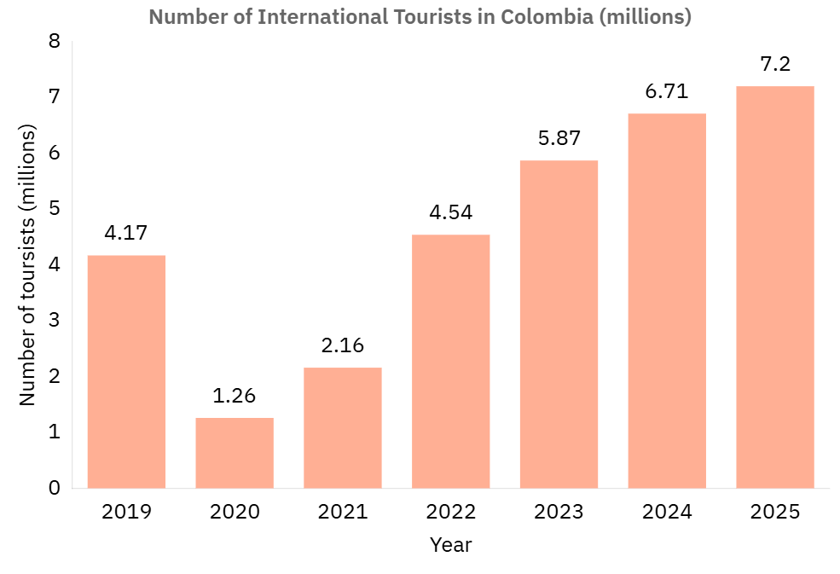
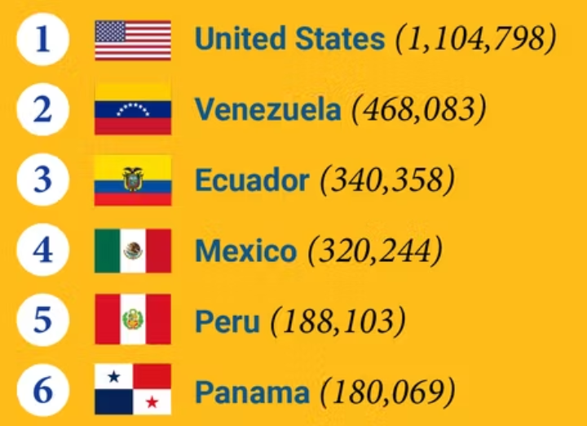
Colombia
Tourism Growth
Travellers
14% YoY growth in international tourism in 2024
2024 arrivals exceeded pre-pandemic levels by 60%
Strong long-term outlook with sustained growth in visitor volume
Price-sensitive leisure segment aligns with SkyLink’s low-cost model
1.4M Colombian diaspora in the U.S. drives strong VFR demand
High cultural familiarity and Spanish-language alignment reduce market friction
Location
“Tourist Arrival By Country – 2024”
Underserved cities like Cartagena and Medellín account for ~40% of Colombia’s tourist arrivals
Below 6-hour flight time meets customer expectations and avoids comfort complaints
Acts as a strategic bridge between North and South America, enabling future network growth

Slide 6

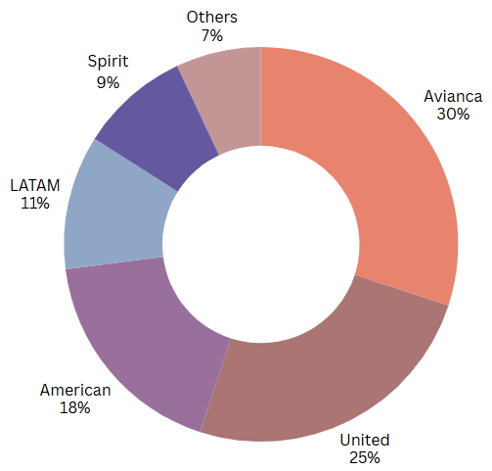
Competitive Landscape
Market Share (%) of US – Colombia routes
Airline | Price Model | Strength | Weakness
Avianca | Hybrid | Broad Colombian network | Post restructure brand recovering
United | Legacy Carrier | Reliable US connections | Limited routes in Colombia
American | Legacy Carrier | High frequency from key US hubs | High ticket fares
LATAM | Legacy Carrier | Network all over South America | Few direct US – Colombia routes
Spirit | Low-Cost Carrier (LCC) | Cheap fares & direct routes | Poor service quality
Others: Includes JetBlue, Delta, Copa, and regional operators. These carriers either operate non-direct or low-frequency US–Colombia routes, have limited network presence within Colombia, or serve niche segments. Combined, they hold a small market share (~7%) and pose minimal competitive threat to SkyLink’s direct, low-cost model.

Slide 7



Low-Cost Carriers (LCC) Landscape & SkyLink's Differentiation
LCC Landscape
VIVA & Wingo collapse
Over-expansion and weak cash positions left both airlines exposed to demand swings and cost increases.
Heavy reliance on Bogotá led to congestion and damaging fare competition.
Regulatory setbacks, including failed merger approvals, hurt credibility.
Takeaway: The market remains attractive but demands a cautious, flexible entry strategy with better route selection and financial resilience.
Common Strategies & Gap
Competitors focus on ultra-low fares, high aircraft use, and minimal extras.
Many are concentrated in Bogotá, leading to delays and pricing pressure.
Limited flexibility in route strategy, with most airlines sticking to traditional corridors.
There is little brand differentiation beyond price, creating space for a new entrant with a sharper value proposition.
SkyLink Advantage
Efficient, sustainable fleet reduces operating costs and emissions.
Secondary city focus avoids congestion and taps into underserved demand.
Local partnerships boost visibility and customer appeal.
Diaspora engagement builds trust through cultural familiarity.
Sustainability focus appeals to conscious travellers and aligns with global trends.

Slide 8
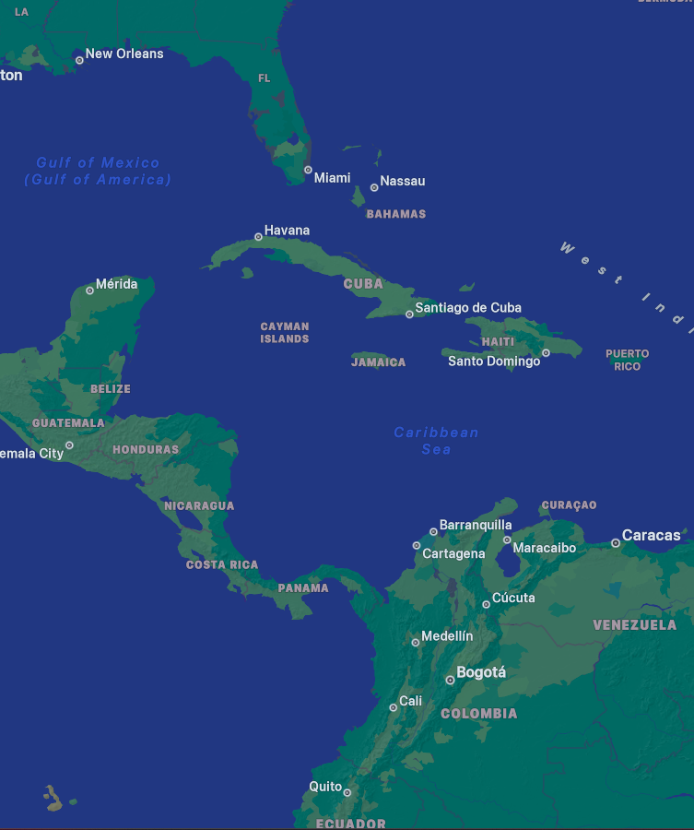
Market Entry Strategy: Routes, Partnerships & Demand Activation
"Route's from Miami to Medellín and Cartagena"
Routes & Demand Activations
Pilot route from Miami to Medellín and Cartagena, avoiding Bogotá due to limited slots and higher congestion
Operates for 6 months, with 2–4 weekly flights to test demand and optimise route economics
2% market share goal, translating to approximately 160 flights per year
Flight schedule concentrated in peak travel seasons to maximise visibility, drive early bookings, and build brand awareness
Brand Positioning and Partnerships
Local Hotels & Resorts: Bundle offers help boost perceived value for customers without cutting ticket prices; also tap into existing hospitality loyalty programmes
Local Government: Co-market routes via digital & local campaigns; governments often support route launches with promotional grants
Car Rental Companies: Loyalty tie-ins and long-stay traveller fit
Telecom Bundles for SIM/data - good for diaspora/VFR traffic

Slide 9
Pricing Strategy
Cost Breakdown to Fly from US (Miami) – Colombia
Fuel: 3.5 hour flight – 3000 litres/hour = 10,500 litres at $0.56/L = $5900
Crew: 2 pilots and 5 cabin crew = $1500
Maintenance: $300/hour = $900
Airport Fees: Landing, handling and terminal use = $2000
Overheads: Spread over all flights (lower than legacy since smaller fleet) = $1000
Taxes and Fees of US airport = $1000
Average total seats in plane used for 3 hour flight: 200
Assuming a 72% load factor (as stated in case for international flights) = 144 passengers/flight
Entry tax for Colombia (included in costs): $38/person = $5500
Total Costs for Skylink/plane = $17,800
Total Cost per Passenger = $123
Break-even: $123
Target Price Range:
$160 - $180
“Target price undercuts all other carriers with a 30% - 45% profit margins and if competitors respond with price drops, our newer, fuel-efficient fleet lets us lower fares further, without taking losses”
Airline | Average One-Way Fare (USD)
Avianca | $200 - $250
American | $250 - $300
United | $300 - $350
LATAM | $250 - $300
Spirit | $150 - $200

Slide 10
Risks & Mitigations
Competitive Risk Response
Client/Execution Risk
Brand Awareness Gap
Macroeconomic & Political Risk
Risks
Incumbent carriers (e.g. Avianca, Spirit) may respond with aggressive fare reductions, additional capacity, or increased frequency
Risk of intensified competition from regional LCCs like Wingo or re-entry by former players (e.g. Viva)
Price pressure could lower load factors and compress margins during launch
Mitigations
Leverage SkyLink’s low-cost base and fuel-efficient fleet to remain profitable even with lower fares
Focus on underserved secondary routes (e.g. Medellín, Cartagena) to avoid direct competition
Use pilot launch during high-demand season to build brand and early customer traction
Risks
Limited international operating experience within SkyLink’s core team
Regulatory, legal, and airport process complexity may cause delays or compliance issues
Internal misalignment between departments (ops, legal, marketing) could disrupt rollout
Mitigations
Assemble a dedicated cross-functional international expansion team with external advisors
Utilise pilot phase to refine operations and establish a repeatable launch model
Leverage U.S.–Colombia Open Skies Agreement to reduce regulatory friction
Risks
Lack of brand recognition in Colombia may reduce consumer trust and booking volumes
Local market may favour established domestic or legacy carriers
Service expectations may differ from U.S. market, risking brand misalignment
Mitigations
Form partnerships with tourism boards, hotel chains, and telecom providers to increase visibility
Target diaspora travellers familiar with SkyLink through digital channels and community outreach
Launch promotions and VFR-targeted loyalty programme to drive trial and build brand familiarity
Risks
Political shifts or regulatory changes may impact air rights, aviation taxes, or foreign carrier policies
Currency fluctuations (USD/COP) could affect fare attractiveness and operational costs
Social unrest, economic downturns, or infrastructure disruptions could impact tourism and flight reliability
Mitigations
Structure pilot route with low capital exposure to test market viability
Price in USD where possible and negotiate supplier contracts with currency flexibility
Monitor political landscape via local partners and maintain optionality for LATAM-wide diversification

Slide 11

Conclusion
Colombia is the optimal launchpad for SkyLink’s international growth strategy
Entry via Medellín and Cartagena offers low-cost scalability and avoids slot constraints
Pilot phase allows for data-led validation before broader roll-out
Strategic partnerships and loyalty initiatives support early traction
Flexible pricing model ensures competitiveness without sacrificing margins
Risk-aware plan includes mitigations for political, operational, and brand challenges
Future plan: Scale across Latin America using Colombia as a hub, expanding to high-potential markets like Peru and Central America

